Slide 1

University Institute of Liberal Arts and Humanities
Course Name: Communication Skills
Course Code: 23PCH-105
NOTE TAKING AND NOTE MAKING
DISCOVER . LEARN . EMPOWER

Slide 2
COURSE OBJECTIVES
The Course aims to:
1 | Augment students overall communication and interpersonal skills by making them realize the importance of good oral and written English Language in professional life.
2 | Enrich their reading capability with special emphasis on expanding vocabulary and grammatical formations.
3 | Build exceptional speaking, reading and writing skills by correcting grammatical errors and pronunciation through practice.
4 | Enhances soft skills by fostering self awareness, confidence and a positive attitude in students’ ability to communicate effectively in English.

Slide 3

COURSE OUTCOMES
Space for visual (size 24)
On completion, the students are expected to
CO Number | Title | Level
CO1 | Apply appropriate Listening, Speaking, Reading and Writing Skills (LSRW Skills) with correct non-verbal cues to attain expertise in soft skills. | Apply
CO2 | Apply correct contextual and comprehensible written text in the form of paragraph writing, short compositions business correspondence, using logical support and argument in a wide range of communication situations. | Apply
CO3 | Demonstrate linguistic competence while speaking and during presentations through accuracy in grammatical usage, vocabulary, pronunciation and intonation. | Apply
CO4 | Evaluate information as critical readers, speakers and writers applying ethics in communication and being sensitive in cross cultural communication. | Evaluate
CO5 | Create original, digital content for websites, blogs, vlogs and personal social media profiles etc. | Create
godseyeblog.com

Slide 4
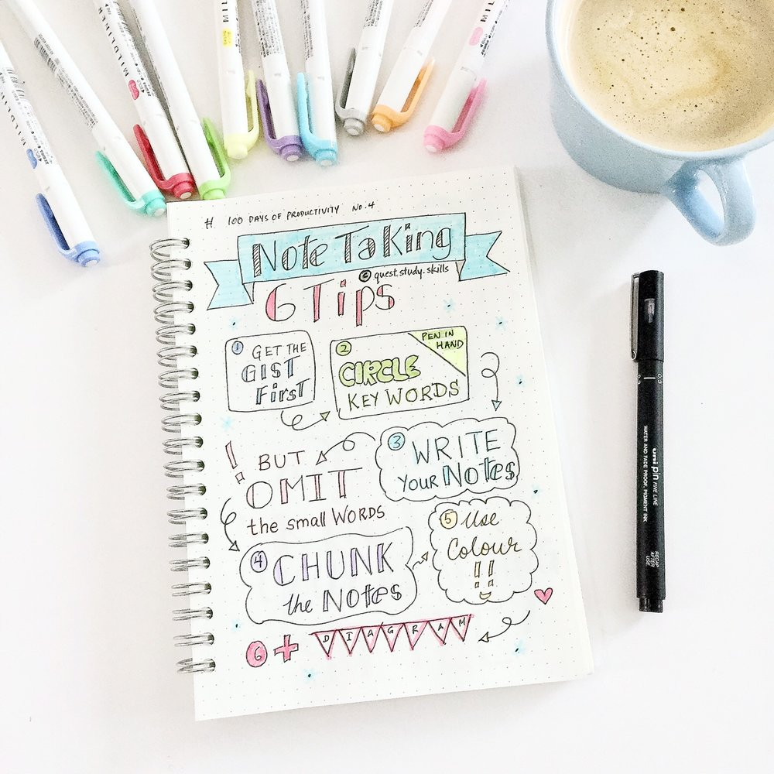
Introduction
Communication : a gradual process of sharing and receiving information.
Knowledge gained to be shared.
Retaining knowledge an essential part.
Note Taking and Note Making helps to accumulate and enhances knowledge.
www.queststudyskills.com

Slide 5
Note Taking VS. Note Making
1. Passive process that involves active listening | 1. Active process that involves critical thinking
2. Process of copy & pasting what ever is being delivered, | 2.Helps to process and reflect on notes taken
3.Points noted during lectures or while reading text | 3.A resource that is self created
4.A way of retaining information | 4.Note making leads to analysis and understanding

Slide 6
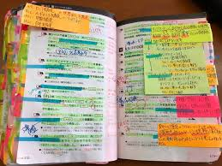
Note –Taking
Essential skill
Enhances Tactile Thinking
Helps move towards
advance level study
Aids in independent learning.
www.mirror.co

Slide 7

Note-Taking (Contd.)
Taking notes in class could be:
Lecture
Workshop
Seminar
Tutorial
Group Work
Fieldwork
Interviews
www.stepp-program.org

Slide 8

Note-Taking In Academics
Don’t write every single word
Record important points
Pre-reading to understand context
Use paraphrases and abbreviation
Review
Reflect
Revise
Experiment! Some students prefer to type, others to write
hsites.google.com

Slide 9
Why Note-Taking In Business?
Information is the lifeblood of business – decisions are made on the information received.
Managers are swamped with information.
Notes communicate information in a shortened, time-saving form
Examples : Minutes, Reports, Articles

Slide 10
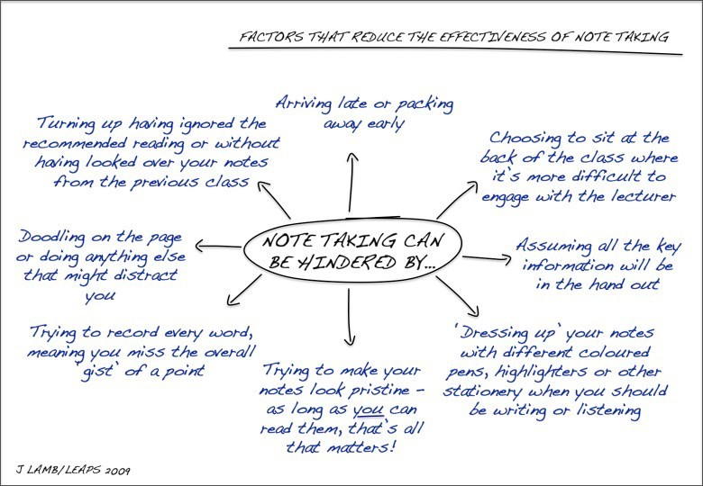
When good notes go bad…?
10

Slide 11
Poll Question-1
An effective strategy for note taking includes an …………. and ………. Approach
Inefficient, systematic
Inefficient, unsystematic
Efficient, systematic
Efficient, unsystematic

Slide 12
Taking Notes While Listening
Abstracting irrelevant information
Selecting and organising
Complementing with visuals
There are many methods to take notes
An example of note-taking: The Cornell Method

Slide 13
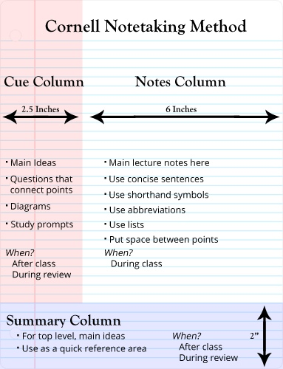
Cornell Note-Taking Method
Note Taking Area- leave spaces to add information later!
Summaries Area-brief summary of that day's notes.
Cue or Question Column-write questions in the margins
pdf.wondershare.com

Slide 14

Five R’s Of Cornell Notes
Record- During Lecture
Reduce-Paraphrase and abbreviations
Recite- Recollect using key words
Reflect- Evaluating facts and application
Review- Reviewing helps in retention

Slide 15
Taking Notes While Reading
Procedure
Skim
Scan -underline the main points
- underline the key words and sentences
- contains main idea of paragraph
Headings
Sub- Headings
Establish the structure (logical sequencing)
Use symbols and abbreviations (e.g., i.e., vs., →, &.....)

Slide 16
Let’s Recall
State whether true or false
Note taking is a passive process involving active listening.
Notebook and pen is essential for taking notes.
Do not write wrong spellings while taking notes.
Adding pictures simplifies your notes.
Jotting down every point while taking notes is essential.
True
False
False
True
False
16

Slide 17
Note Making
Note-Making: resource you create yourself.
Concise
Clarifies class notes
Helps in easy understanding and Connecting ideas
Organized content for exam revision

Slide 18
Note Making(Contd.)
From reading:
Be certain of purpose
Avoid copy pasting
Skimming helps in getting main theme
Organise thoughts
Understand the structure
Use highlighters sparingly
Deadline necessary for reflection

Slide 19
Note-Making : Styles and Techniques
There is no one ‘right’ method.
Original notes from class or reading.
These are longer and less concise.
Making them shorter will aid understanding and help identify learning gaps.
Notes are reduced by about half by this stage.
By now, notes are much shorter.
slideplayer.com

Slide 20
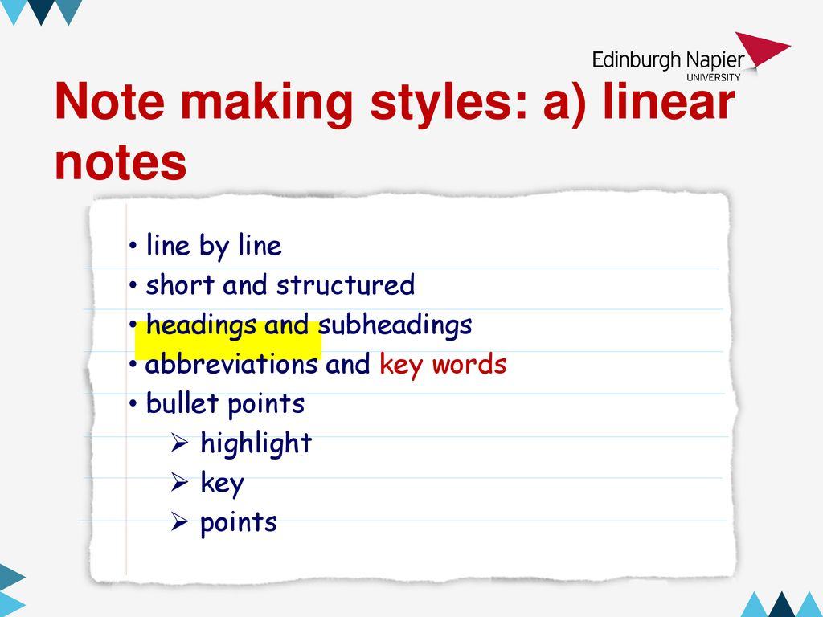
Note-making : Styles and Techniques (contd.)
Linear Notes
1. Notes in list form.
2. Look neat in logical order
3. Have nice heading and subheading
4.BUT… encourage to copy down rather than think about ideas.
5. AND… less flexible in linking ideas
slideplayer.com

Slide 21
Note-making : Styles and Techniques (contd.)
Spider Diagrams/Mind Maps
Must not forget
this point.
Theme one might go here.
Making Useful Notes
Ooh – this other idea is connected too!
Don’t forget how two
and three link together.
Theme three goes here
Theme two goes here.
slideplayer.com

Slide 22
Importance of Note Making
Helps in understanding topics
Identifies areas which needs clarification
Allows you to start thinking about assessment
Forces you to think logically and methodically
Helps you track progress through courses
Prepares you for exams as well as projects
Helps you to reflect regularly to ensure retention

Slide 23
Get Organised!
Separate Note book for every subject
Organised notes leads to easy access
Confusion and misunderstanding clarified quickly
Be systematic, whether that’s by subject, topic, week, class, semester etc.
Sense of achievement and satisfaction
Disorganised notes = disorganised student.
Disorganised student = stressed student.
Well written notes retained for longer periods

Slide 24
Poll Question-2
What are Cornell Notes?
Music in the written form
A note taking system used for organising notes
Notes that are taken in computer class
A note that is written to a friend

Slide 25
Practice Question
Watch this Video
https://www.ted.com/talks/elizabeth_cox_what_is_a_coronavirus/up-next?language=en#t-45

Slide 26
Practice Question(Contd.)
Answer the following questions based on shared video
1. Make notes using recognizable abbreviations for the video using Cornell Note Taking method.
2. Write down at least five key words used in the video.

Slide 27
APPLICATIONS
Applicable to personal and professional life
Will strengthen the Note-Taking and Note-Making skills of students
Students will be able to write take better notes in classroom and at workplace in future.

Slide 28
Assessment Pattern
Students are assessed on the basis of the following parameters:
Hourly Test- 2
Assignments
Surprise Test
Quiz
Engagement Task
End Semester Exam

Slide 29
REFERENCES
www.leapsacademicskills.net/uploads/2/0/7/0/2070115/note_taking_slides.pdf
https://www.missiontolearn.com/note-taking/
http://tutorials.istudy.psu.edu/notetaking/notetaking8.html
https://library.leeds.ac.uk/downloads/file/452/tutor_workshop_powerpoint

Slide 30
THANK YOU
For queries
Email: communicationskills.uilah@gmail.com

